Slide 1
golang
emus
Ignacio Sánchez Ginés
@drhelius

Slide 2
Emulador = legal
ROM = ilegal

Slide 3
Emulador ≠ Simulador

Slide 4
Interpreter
LD A,(HL)
SUB 1
JR C,CONTINUE
CP B
JR NZ,LOOP
Read
Decode
Exec

Slide 5
Binary Translation
LD A,(HL)
SUB 1
JR C,CONTINUE
CP B
JR NZ,LOOP
Target
Machine
Code

Slide 6
Dynamic Recompilation
Read
LD A,(HL)
SUB 1
JR C,CONTINUE
CP B
JR NZ,LOOP
Target
Machine
Code
Trans
Exec

Slide 7
Video
CPU
MEM
Audio
IO
Input

Slide 8
CPU
6502
Z80
NES
Atari 2600
Commodore 64
Apple 2
Super NES 65816
Game Boy *
Master System
Game Gear
MSX
ZX Spectrum

Slide 9
CPU
8-bit
MEM
16-bit

Slide 10
0
0000
16KB
16KB
16KB
16KB
65535
FFFF

Slide 11
opcode
opcode
opcode
8DC4F3CD293D2144FF3E92BE20FDCD0C
........
parameter
parameter

Slide 12
Main Loop
while true { updateCPU() updateVideo() updateInput()
updateAudio() }

Slide 13
updateCPU() {
opcode = fetchOpcode() runOpcode(opcode) }

Slide 14
CPU
Video
Input
100 clks
N clks

Slide 15
Game Boy
Video
MEM
CPU
4 MHz
Audio
Input
Cart
Timer

Slide 16
CPU
PC
SP
H
L
A
F
B
C
D
E
16 bit
8 bit

Slide 17
Flags
Z
N
H
C
0
0
0
0
7
6
5
4
3
2
1
0

Slide 18
0000
16 KB ROM Bank 0
4000
cartucho
16 KB switchable ROM bank
8000
8 KB Video RAM
A000
8 KB switchable RAM bank
cartucho
C000
8 KB internal RAM
E000
Mirror 8 KB internal RAM
FE00
Sprite Memory (OAM)
FEA0
Empty
FF00
IO Ports
FF4C
Empty
FF80
Internal RAM
FFFF
Interrupt Register

Slide 19
1
2
j
j+1
i
i+1
X
N

Slide 20
0000
16 KB ROM Bank 0
4000
16 KB switchable ROM bank
8000

Slide 21
00000
Bank 0
fixed
04000
Bank 1
switchable
08000
Bank 2
0C000
Bank 3
10000
Bank 4
Bank 4
14000
...

Slide 22
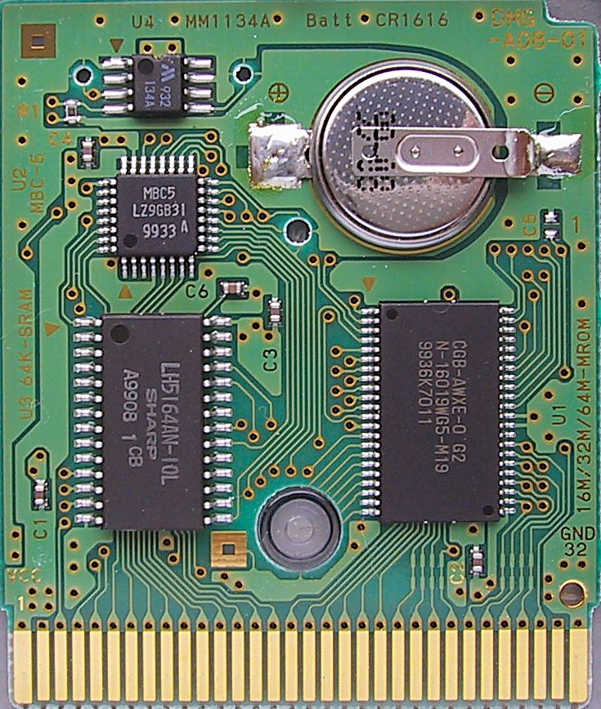
MBC
RAM
ROM

Slide 24
48.6 us
Visible
160x144
HBlank
VBlank
1.08 ms

Slide 25
Demo Emulator
cpu
core
video
main
glfw
input
opengl

Slide 26
Workshop
go get -u github.com/drhelius/demo-emulator
cd $GOPATH/src/github.com/drhelius
go run main.go -rom workshop.rom

